Slide 1


Slide 2
Group Members
Yamin Khan 242464
Abdur R. Qureshi 242466
Ruman Shaikh 242469
Haadiya Sayed 242467
Guide
Ms. Swati Ganar

Slide 3
Problem Statement
Students and campus users struggle with slow, inconvenient print services
Long queues and unreliable campus printers cause delays
Need for quick, reliable printing and stationery access on or near campus
Printhub answers this with next-day delivery and easy online ordering.

Slide 4
What is Printhub?
Print Solutions:
A web platform where users upload PDFs or images to print, ready for next-day pickup at college.
Stationary Store:
Also offers convenient online purchase of stationery items with the same simple process.
Target Audience:
Designed for students, faculty, and anyone needing fast, quality print solutions.

Slide 5


Slide 6
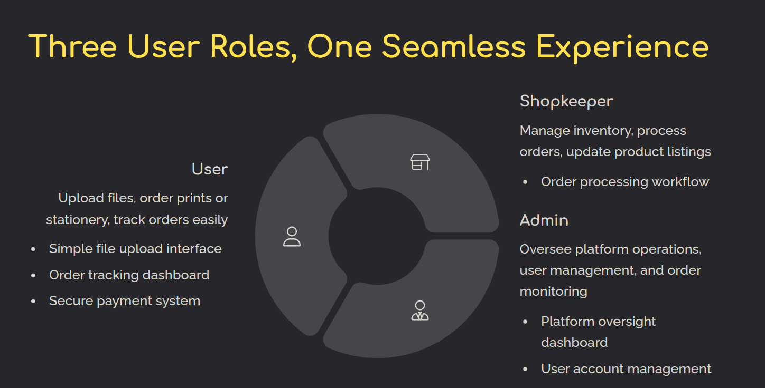

Slide 7
Security & Reliability You Can Trust
Secure File Storage:
Files stored securely with Pinata’s decentralized cloud storage, ensuring data Integrity and privacy.
User Authentication:
User authentication via Clerk and role-based access control protect data and operations with industry-standard security
Built with enterprise-grade security protocols and encrypted data transmission for complete peace of mind.

Slide 8
Features of Printhub
Order Customizations
Efficient and Reliable Service
Cheap and fast for students
24x7 availability
Supports mobile devices

Slide 9
So far Printhub has achieved…
2000+ pages printed
Rs. 4500 earned so far (of which 20% profit)
3 Months up and running
Delivered within 24 hours
10 emergency orders delivered in 15 minutes
Expanded to entire IT Branch of MHSSCOE by 2026

Slide 10
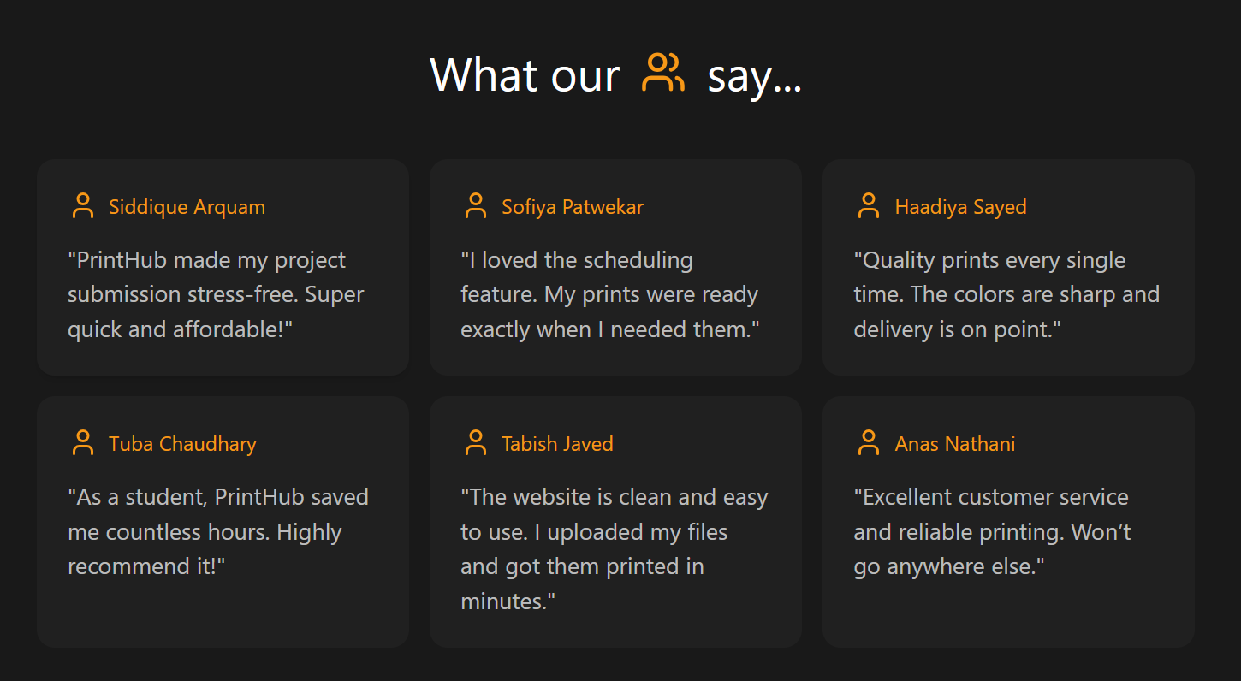

Slide 11
Thank You Feel free to ask more questions Visit: https://print-hub-speed.vercel.app/

